Slide 1
EVOLUNTEER SYSTEM
AMIRUL adli Fahmi bin azam (2019447362)

Slide 2
Introduction
eVolunteer System is a web-based application that use XAMPP to host the SQL Database and run Apache Server for PHP.
The web system is made from PHP Language, JavaScript and HTML.
The system is targeted for user who like to do volunteering program/services and for user who can organize a volunteering program/services.
Developed and design by Amirul Adli Fahmi bin Azam.

Slide 3
objectives
the objectives for the system, eVolunteer is to keep help the user to gather and help each others by doing a volunteering services.
to help make end user to suggest, participate or organize a volunteering program/services, much easier.
to help the user to find the volunteer program they wanted or suggest one if not available.
to help awareness among community to help each others more.

Slide 4
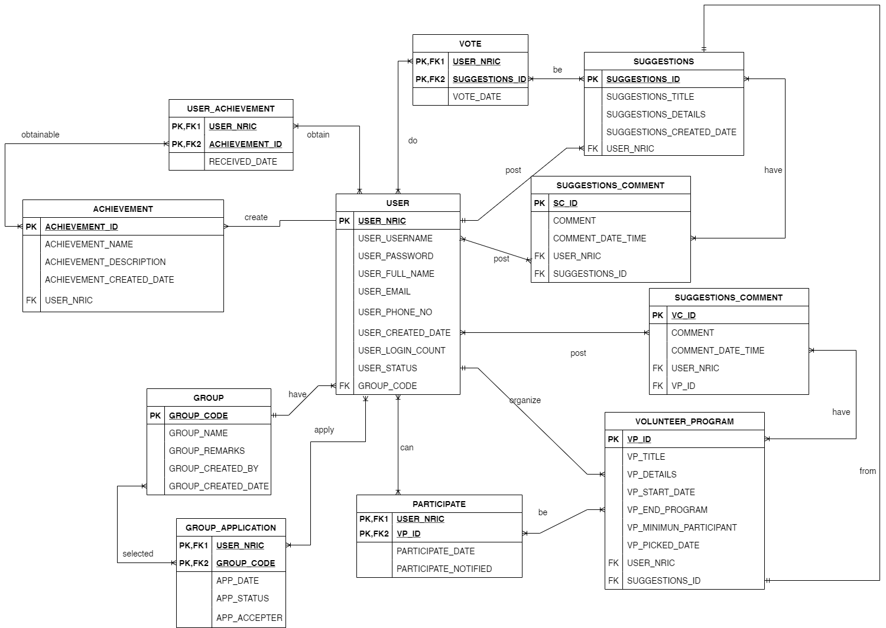
Entity Relationship Diagram (ERD)

Slide 5
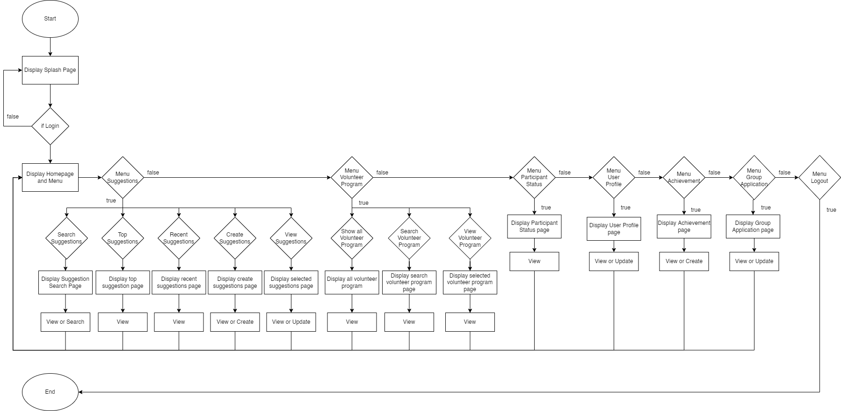
Flowchart : USER

Slide 6
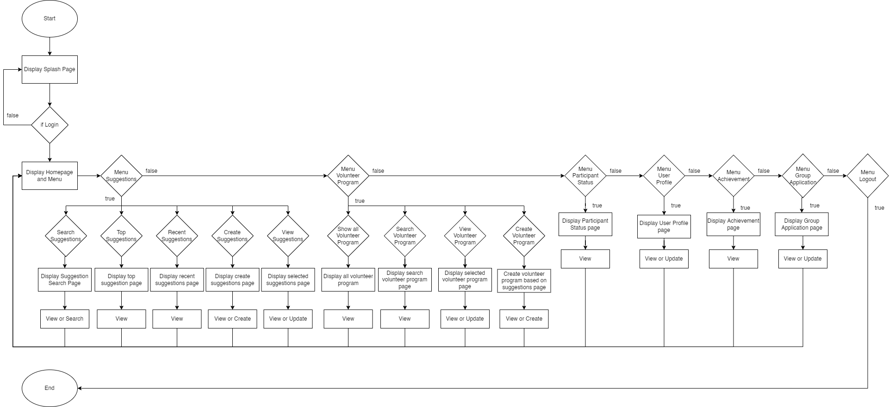
Flowchart : ORGANIZER

Slide 7

Flowchart : ADMIN

